Slide 1
Akshat Karambe Maitri Brahmbhatt Mayur Bhat Nupur Dongare
Data Warehousing and Business Intelligence
Ad-Hawks
Group 2

Slide 2
Introduction
Healthcare in the United States is expensive! An accident causes not just physical, emotional and psychological damage, but economic too.
Approximately 15% of the population is over 65 years of age.
Approximately 12% of the population falls below the poverty line.
Our goal is to test out the efficiency of dispersion of funds for these two government health programs
The scope of this project is to visually understand government spending on Medicare and Medicaid across the 50 states and provide recommendations for resource allocation

Slide 3
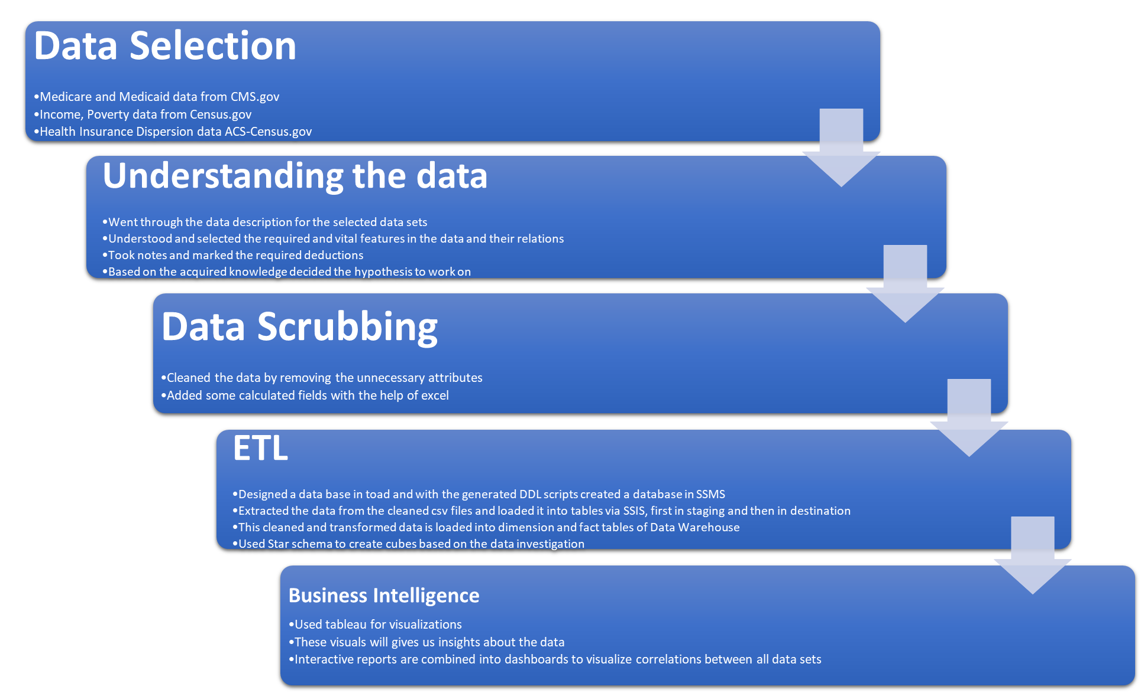
ETL Process

Slide 4
Data Selection, Understanding Data and Data scrubbing
Data taken from cms.gov, census.gov and open source data kff.org.
Approximately 22 data files shortlisted for Analysis. Data chosen for years 2015 and 2016.
Some of the issues faced during transformation are:
Data is inconsistent across the various years
Error rates in population data was throwing off the totals in our tables. Needed to be handled properly.
Income data wasn’t available at a demographic level, this needs some calculated data.
Methods used to clean and transform data
Utilized Excel Macros to insert blank rows in source file.
Used advanced lookup like VLOOKUP and HLOOKUP to get data at a state/age group/gender/race level.
Medicare and Medicaid data which is available only at age group level can now be transformed to indicate costs and expenditures at a demographic level.

Slide 5
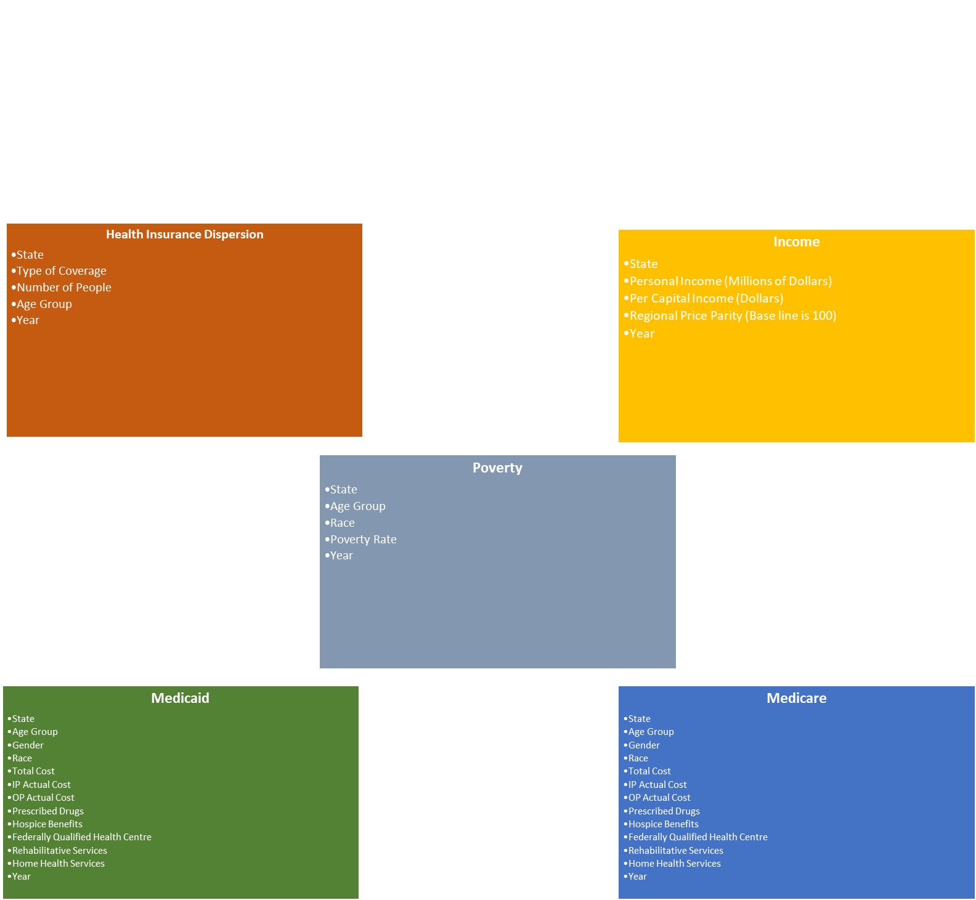
Final Tables after Transformation

Slide 6
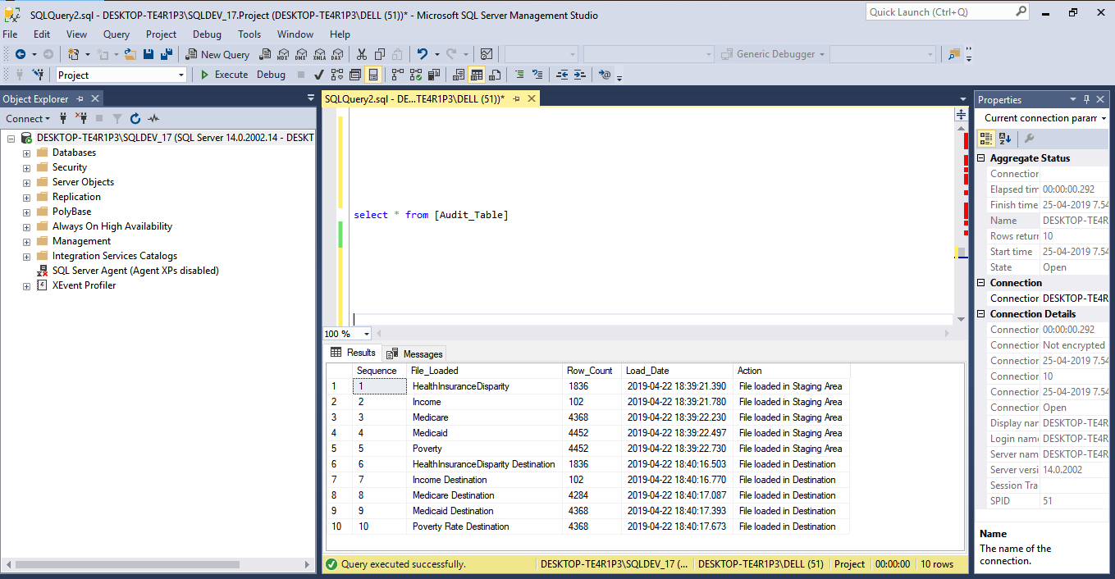
Audit Table

Slide 7
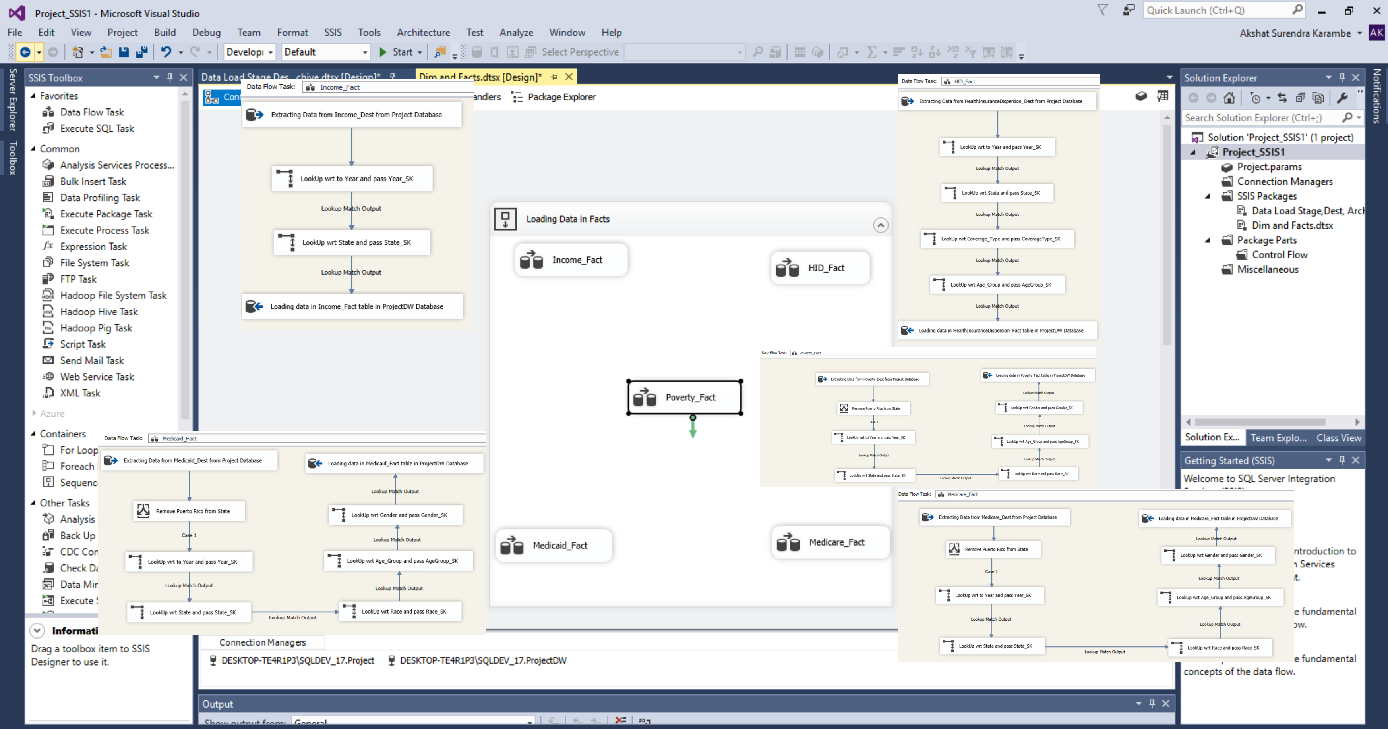
Final Data loading model

Slide 8
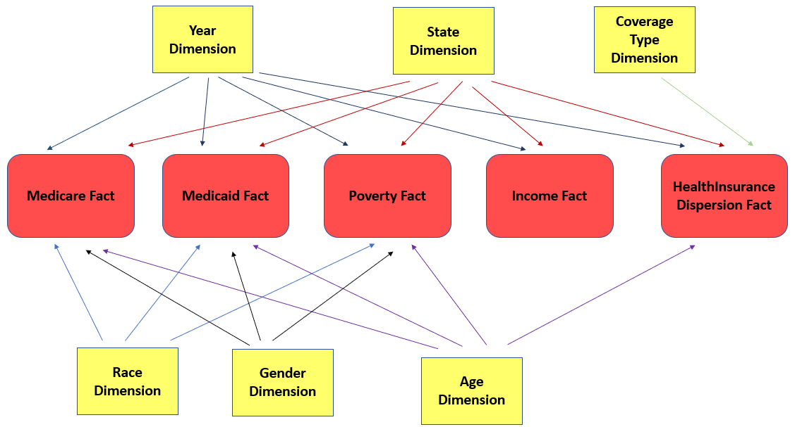
Extract, Transform and Loading

Slide 9
VISUALIZATIONS

Slide 10
Conclusion
In conclusion, we can say that Medicare and Medicaid spending is consistent in states with lower income/higher percentage of poverty
But in states where the income levels are higher, we see some disparity in government spending patterns.
Our recommendation would be that the government prioritize their spending on regions with lower income to maximize the effectiveness of resource allocation for improved health

Slide 11
Thank You

